Slide 1

AIML Group Lab Team 12
Weeds Detection using Deep Learning

Slide 2
Agenda
Problem Statement
Introduction to Team
Response to the Questionnaire (Refer Abstract)
Business Applications, Post course
Q & A

Slide 3
Problem Statement
Weed detection in crop field using deep learning with unsupervised data labeling on UAV( Unmanned Aerial Vehicle) images

Slide 4
Team
Team Member 1 – Divya Goswami
Team Member 2 – Kunal Sinha
Team Member 3 – Nisha Nagendrappa
Team Member 4 – Parihar Singh
Team Member 4 – Sudip Roy

Slide 5
Dataset
We need a dataset of the images are captured by the UAV.
why we chose this dataset ?
Weeds detection and characterization represent one of the major challenges of the precision agriculture.
The use of Unmanned Aerial Vehicle (UAV) is fast becoming an interesting vision based acquisition system, since it enables rapid acquisition of the entire crop area with a very high spatial resolution and at low cost.

Slide 6
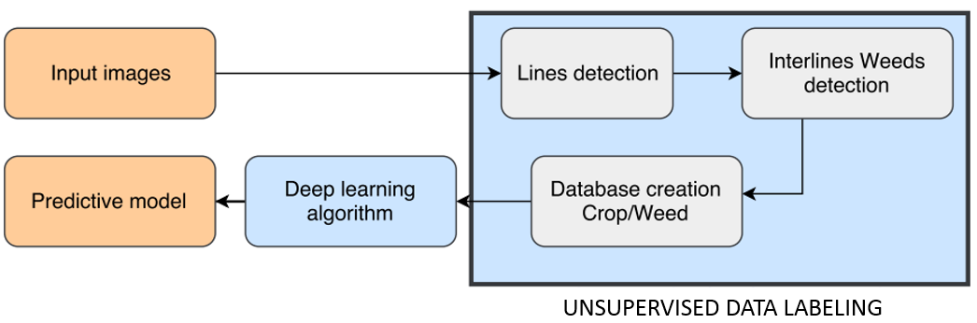
Proposed Method
1. Several studies have used geometric property for weed detection (known as inter-line weed).
2. The main advantage of such technique is that it is unsupervised and does not depend on the training data.
3. Intra and inter line vegetation are then used to constitute our training database which is categorized into two classes crop and weed.

Slide 7
(Pre-processing)
Crop Line Detection
The aim is to detect the main line of each crop row. For that purpose we have used a Hough transform to highlight the alignments of the pixels.
Before starting any line detection procedure, generally pre-processing is required to remove undesirable perturbations such as shadows, soil or stones.
Here we can use the ExG (ExG = 2g- r –b ) with the Otsu adaptive thresholding to discriminate between vegetation and background.
SLIC is simple and efficient in terms of results quality and computation time, hence we are using it to delimit the crop rows i.e generating mask for crop rows.

Slide 8
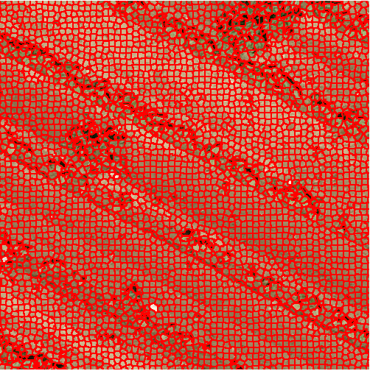
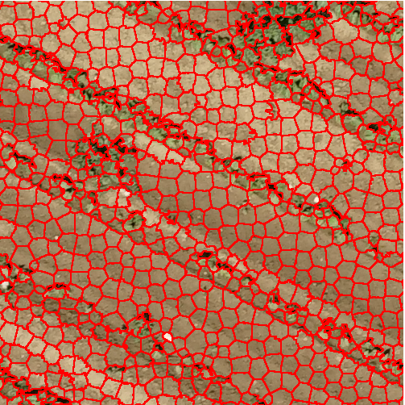
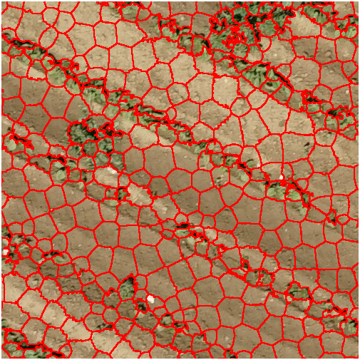
Fig. : Examples of superpixels computed on images of dimensions N=7360 x 4912.

Slide 9
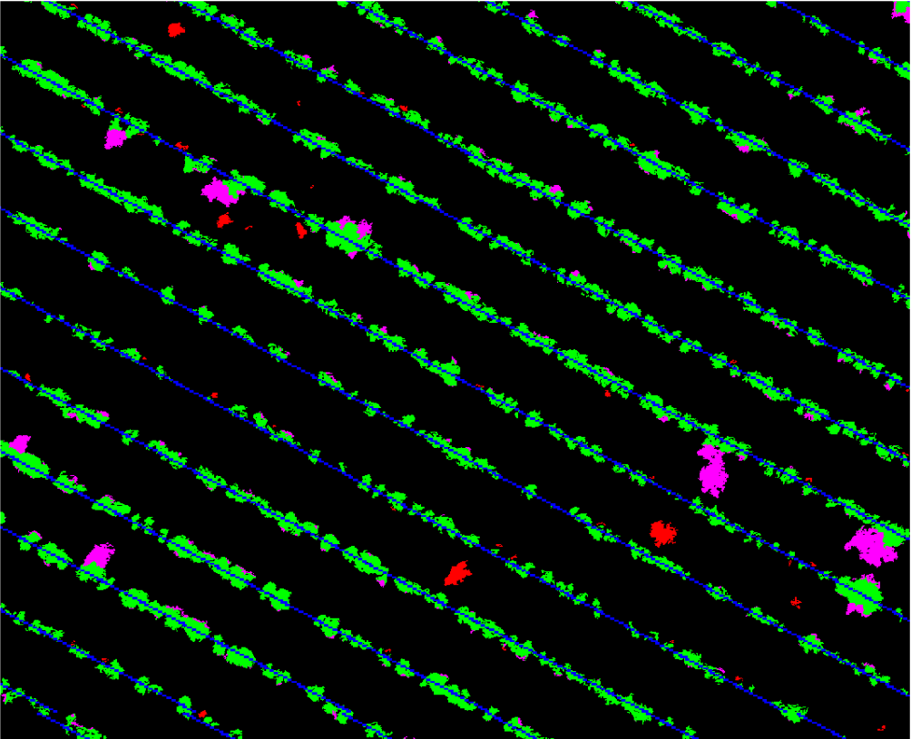
Unsupervised training data labeling
Once the crop is identified, next step consists in detection of the interlines weeds. Interline weed is plant which grows up in the interline crop. To detect weeds that lie in inter-row we performed a blob coloring algorithm.
Hence any region that does not intersect with the crop mask is regarded as weed.
To construct the training dataset, we extracted patches from the original images using positions of the detected inter-row weeds and crops.
For weeds samples we performed bounding boxes on each segmented intra-row weed. For the crop samples, sliding window has been applied on the input image using positions relative to the segmented
crop lines.
Fig. shows the mask of crop, interline weeds and potential weeds.

Slide 10
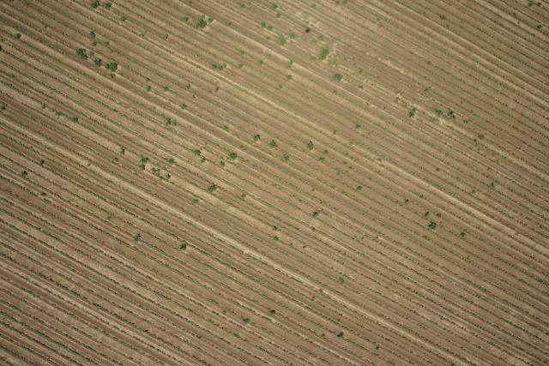
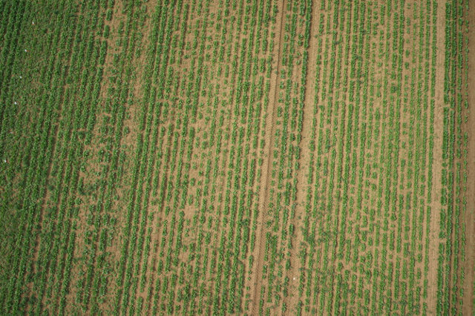
Crop/Weeds classification using Convolutional Neural Networks
In this work we used a Residual Network (ResNet) with 18 layers.
We performed fine tuning to train the networks in our data.
Fine-tuning means that we start with the learned features on the ImageNet dataset, we truncate the last layer (softmax layer) of the pre-trained network and replace it with new softmax layer that are relevant to our own problem.
Here the thousand categories of ImageNet have been replaced by two categories (crop and weeds).
Example of images taken in the bean (a) and spinach fields (b). The bean field has less interline weeds and is
predominately composed of potential weeds. The inter-row distance is stable and the plant is sparse compared to the spinach
field which presents a dense vegetation in the crop rows and irregular inter-row distance. Spinach field has more interlines
weeds and it has few potential weeds.

Slide 11
Expected End Results
We found the results on test data with ResNet18 network.
Field % of unsupervised data labeling % supervised data labeling
Bean 88.73 94.84
Spinach 94.34 95.70

Slide 12
Thank you!

